Slide 1


CUSTOMER RETENTION ANALYSIS
DASHBOARD
By
Shoven Dubey

Slide 2
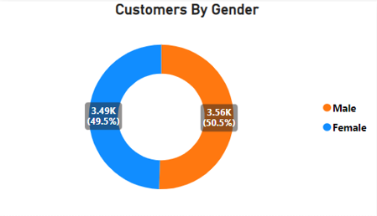

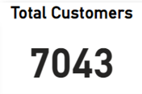
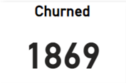





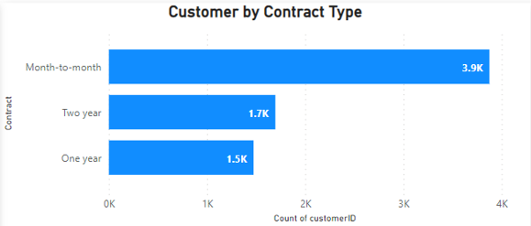
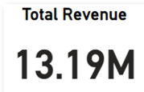

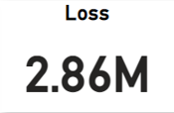


CUSTOMER REPORT
The Gender Distribution is Even. A large Segment of our customer prefer Month-to-Month Contract with us. Of the 7,043 Customers ,3968 Customers have M-o-M Contract, Which is approx. 55% of our Customers.

Slide 3
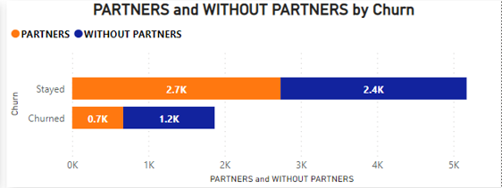
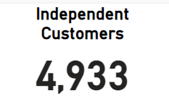
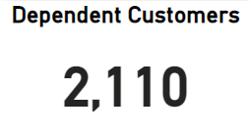
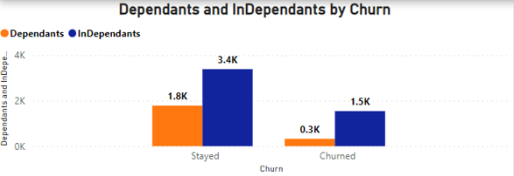



CUSTOMER REPORT
Marital Status and Dependence of Our customers Doesn’t have Much impact on them Staying or Churning

Slide 4

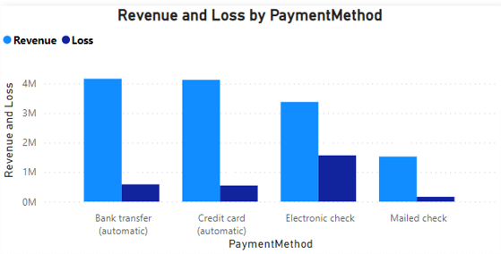
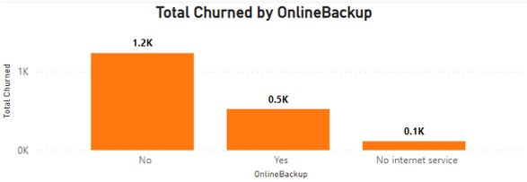

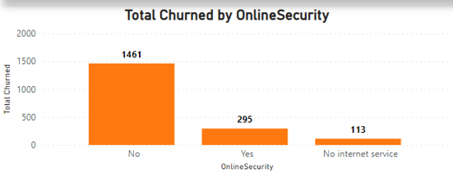
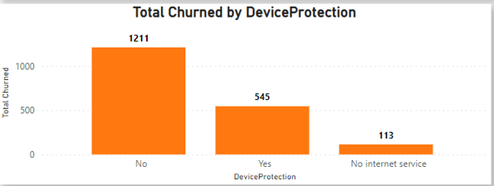

Churn Rate based on Subscription
A Large Percentage of the customers that churned didn’t Subscribed for the services offered: Online Security(78.15%), Online Backup(67%), Device Protection(64.79%). The rate of the Subscription Should therefore be looked into so as to allow more of the customers subscribe to the end that they stay with us.
A large percentage of that churned pays using Electronic Check(57.30%), we should Find out the issue with our Electronic check mode of Payment and have the issues fixed.

Slide 5
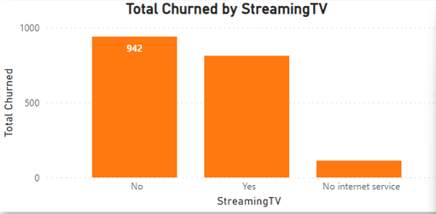
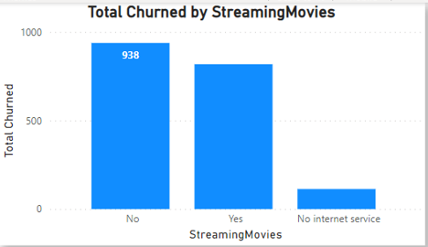
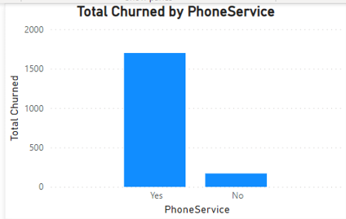
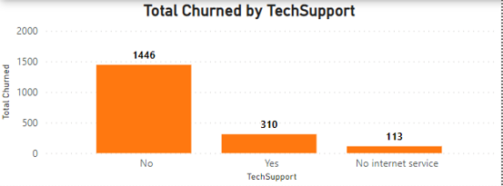
Churn Rate based on Subscription
The Streaming Service (Streaming TV, Streaming Movies) doesn’t have a major impact on the rate at which customers churn.
A large percentage (90.91%) of the customers that subscribe for Phone Services are churning . Our Phone Services should be looked into in order to retain more customers.

Slide 6
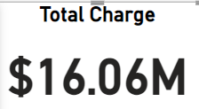


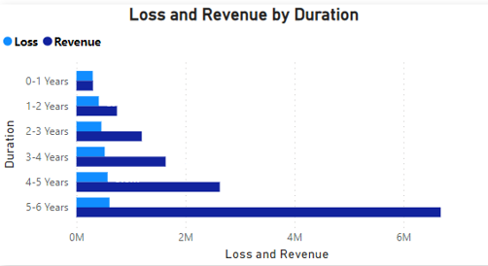
REVENUE & LOSS
Customers who has been with us for 5+ years are our top customers with percentage revenue from 4-5 years at a 31.11% while 5+ years is 50.66%
The highest percentage of loss recorded is from customers who has been with us for 4-5 years with 36.82% loss(churn) and Using Electronic Check.
Knowing that most of our customers use Electronic Check as a means of payment, it contributing 25.60% to our revenue shows that we need to find out issues with our Electronic check and have it Fixed.

Slide 7
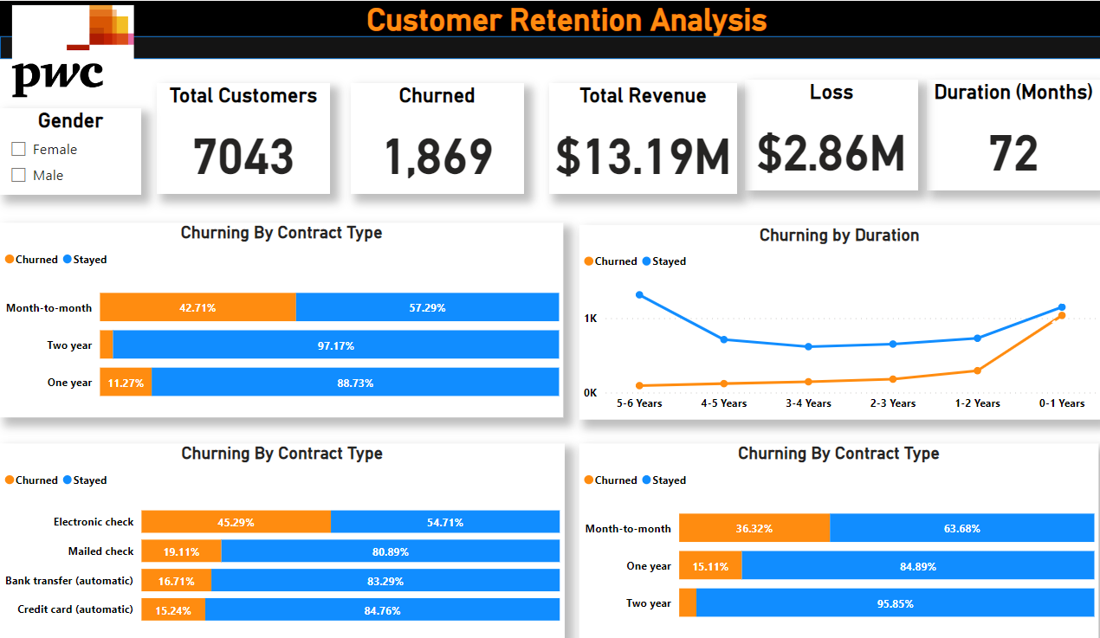
Dashboard 1

Slide 8
Return to Home Page
Project End Here

